Slide 1
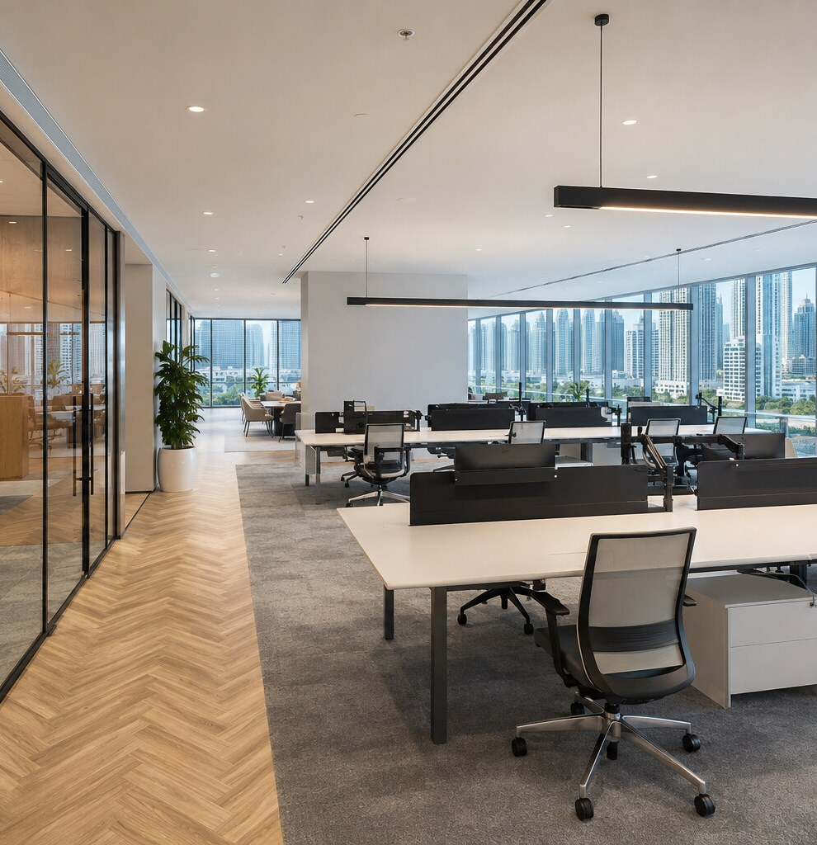

TREGONING
OFFICECARE
All Maintenance Matters
PROFESSIONAL OFFICE MAINTENANCE
FOR DUBAI BUSINESSES
Tregoning OfficeCare provides planned preventative maintenance and responsive support for Dubai workplaces. Our skilled team helps keep your office comfortable, presentable and operating efficiently throughout the year.
tregoningmaintenance.com
PAGE 1 OF 6
Notes:
[Sources]
Office photography: AI-generated for Tregoning OfficeCare by OpenAI, 5 August 2026.
Plan scope and prices: Tregoning OfficeCare working proposal, 5 August 2026.

Slide 2
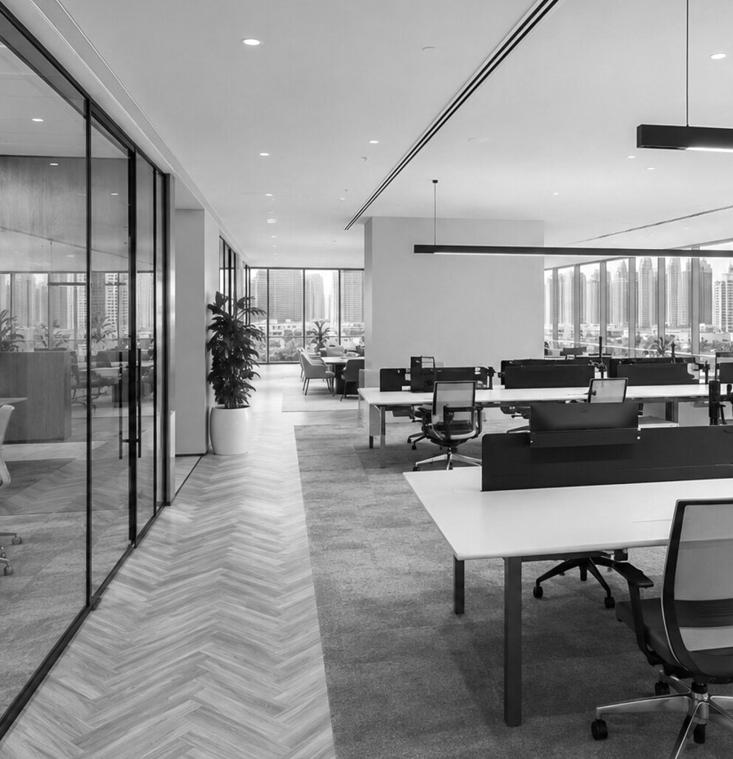
A PROFESSIONAL APPROACH
TO OFFICE MAINTENANCE
A well-maintained office supports your people, protects your premises and reduces disruption. We manage essential maintenance to a consistently high standard, allowing your team to concentrate on business.
EXPERIENCED
PROFESSIONALS
A skilled team with the technical expertise and local knowledge required for commercial premises.
RELIABLE
& TRUSTED
Clear communication, dependable attendance and properly recorded service visits.
QUALITY
ASSURED
Quality workmanship and proven methods for dependable, long-lasting results.
tregoningmaintenance.com
PAGE 2 OF 6
Notes:
[Sources]
Office photography: AI-generated for Tregoning OfficeCare by OpenAI, 5 August 2026.
Plan scope and prices: Tregoning OfficeCare working proposal, 5 August 2026.

Slide 3
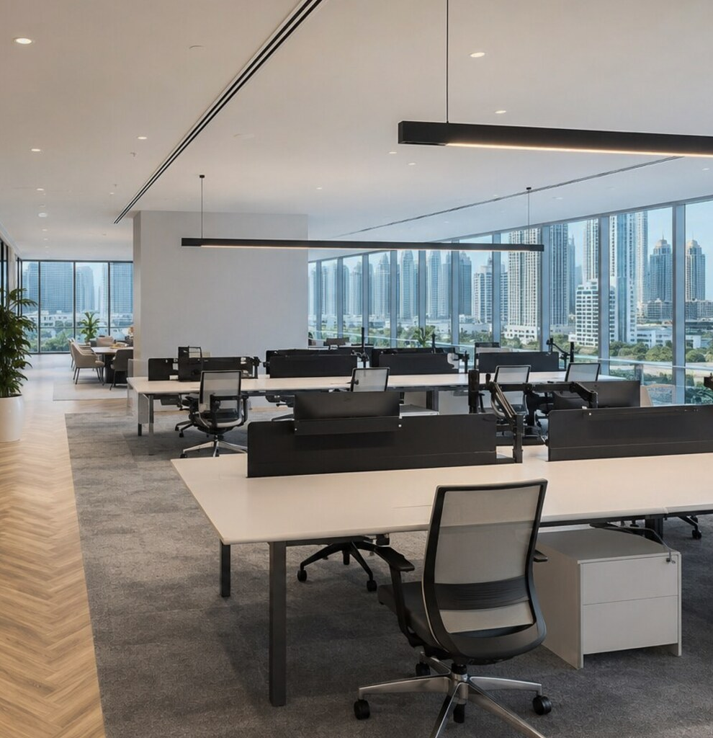
THE VALUE OF
PREVENTATIVE MAINTENANCE
Regular maintenance helps prevent disruption, control repair costs and extend the working life of your office systems and finishes. Our proactive approach keeps your workplace operating smoothly.
CONTROL COSTS
Planned care helps reduce expensive emergency repairs and avoidable downtime.
PROTECT ASSETS
Routine inspections help protect equipment, finishes and the value of your premises.
REDUCE DISRUPTION
One dependable contact manages maintenance issues with minimal interruption to your team.
SUPPORT YOUR TEAM
A comfortable, safe and well-presented office supports staff and visitors.
tregoningmaintenance.com
PAGE 3 OF 6
Notes:
[Sources]
Office photography: AI-generated for Tregoning OfficeCare by OpenAI, 5 August 2026.
Plan scope and prices: Tregoning OfficeCare working proposal, 5 August 2026.

Slide 4
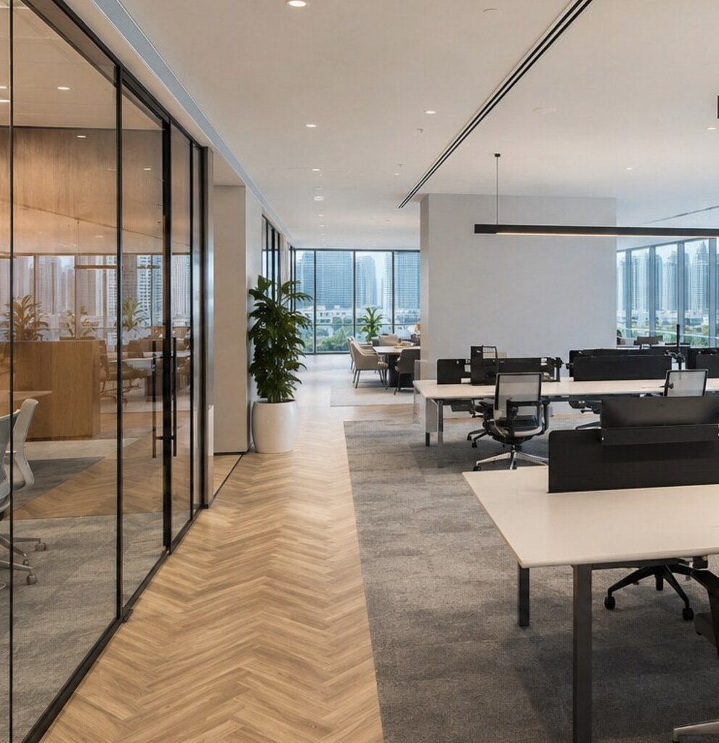
YOUR OFFICECARE
PLAN INCLUDES
OfficeCare covers the essential maintenance needs of your workplace. Final scope is confirmed following a site survey and asset review.
✓
GENERAL MAINTENANCE
Routine inspections and minor repairs to keep your workplace safe and presentable.
✓
MEP SYSTEMS
Electrical, plumbing and mechanical systems inspected and maintained.
✓
AIR CONDITIONING
Scheduled AC servicing, including filters, coils and accessible drain lines.
✓
OFFICE FIXTURES
Minor attention to doors, locks, fittings, finishes and office pantry fixtures.
tregoningmaintenance.com
PAGE 4 OF 6
Notes:
[Sources]
Office photography: AI-generated for Tregoning OfficeCare by OpenAI, 5 August 2026.
Plan scope and prices: Tregoning OfficeCare working proposal, 5 August 2026.

Slide 5
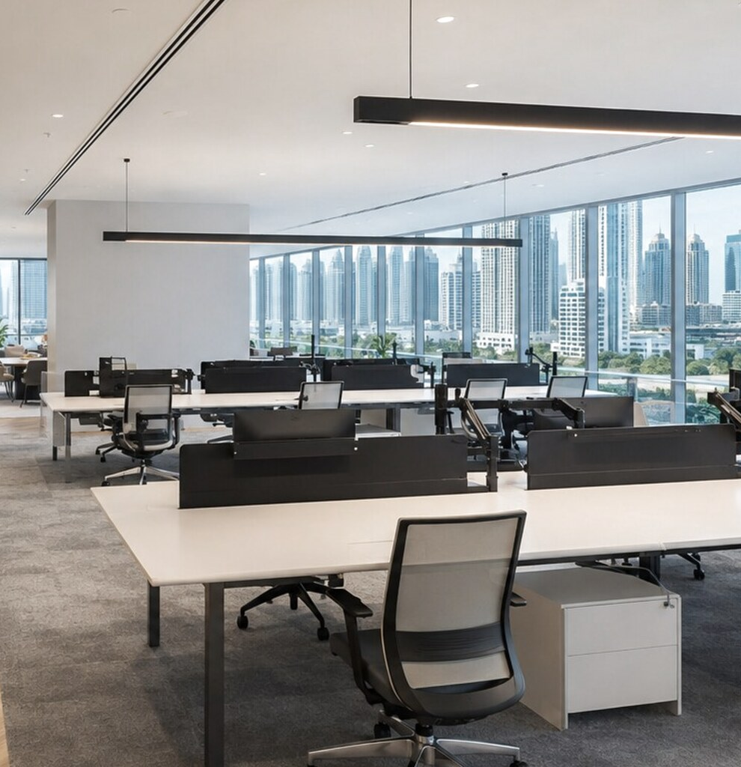
OFFICECARE PLANS
Three levels of office cover, combining strong premium-market benefits with clear limits and prices positioned approximately 10% below comparable top-rate packages.
ESSENTIAL / PLUS / PREMIUM
Up to 1,000 sq ft: AED 4,950 / 9,950 / 14,950
1,001-2,500 sq ft: AED 7,950 / 16,950 / 24,950
2,501-5,000 sq ft: AED 12,950 / 25,950 / from 39,950
Excludes 5% VAT. Over 5,000 sq ft: survey required.
tregoningmaintenance.com
PAGE 5 OF 6
Notes:
[Sources]
Office photography: AI-generated for Tregoning OfficeCare by OpenAI, 5 August 2026.
Plan scope and prices: Tregoning OfficeCare working proposal, 5 August 2026.

Slide 6
CONTACT US
OTHER SERVICES
058 585 1190
OFFICE REFURBISHMENTS
OFFICE FIT-OUT WORKS
fixit@tregoningmaintenance.com
PAINTING & DECORATING
AIR CONDITIONING SERVICES
tregoningmaintenance.com
ELECTRICAL SERVICES
PLUMBING SERVICES
FLOORING INSTALLATION
PARTITION & CEILING REPAIRS
CARPENTRY & JOINERY
HANDYMAN SERVICES
tregoningmaintenance.com
COMMERCIAL MAINTENANCE
PAGE 6 OF 6
Notes:
[Sources]
Office photography: AI-generated for Tregoning OfficeCare by OpenAI, 5 August 2026.
Plan scope and prices: Tregoning OfficeCare working proposal, 5 August 2026.

